Slide 1
Protein Structure

Slide 2
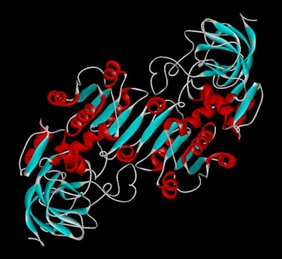
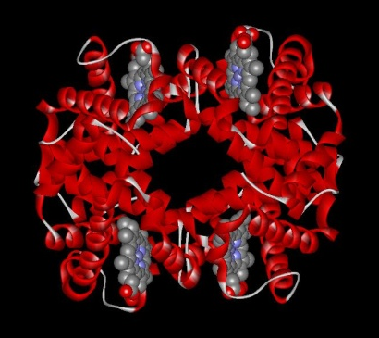
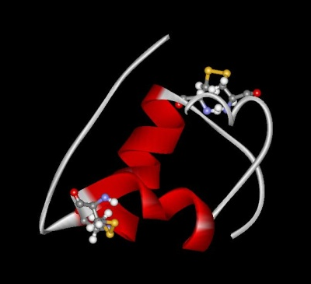
Protein Functions
Three examples of protein functions
  Catalysis:
  Almost all chemical reactions in a living cell are catalyzed by protein enzymes.
  Transport:
  Some proteins transports various substances, such as oxygen, ions, and so on.
  Information transfer:
  For example, hormones.
Alcohol dehydrogenase oxidizes alcohols to aldehydes or ketones
Haemoglobin carries oxygen
Insulin controls the amount of sugar in the blood

Slide 3
Amino acid: Basic unit of protein
R
Different side chains, R, determine the properties of 20 amino acids.
NH₃⁺
C
COO⁻
Amino group
Carboxylic
acid group
H
An amino acid

Slide 4

Chirality of Amino Acids
R
4 different groups with central carbon (alfa carbon).
R denotes the alkyl group.
The most obvious impact of chirality is seen in the shape of molecules.
NH₃⁺
C
COO⁻
H

Slide 5
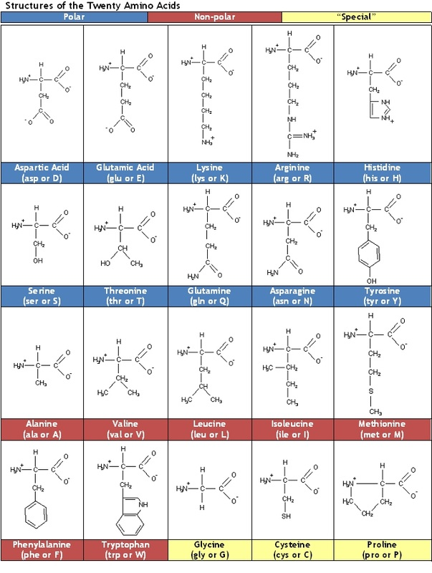
20 Amino acids
*
*
* Essential Amino Acids
*
*
*
*
*
*
*

Slide 6
Ionic Character of Amino Acids
At physiological pH (7.4) - zwitterionic
R
NH₃⁺
C
COO⁻
H
(-) amino acids are predominant in living systems.
(+) occur only rarely (e.g., in antibiotic peptides).

Slide 7
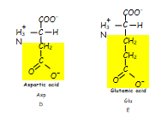
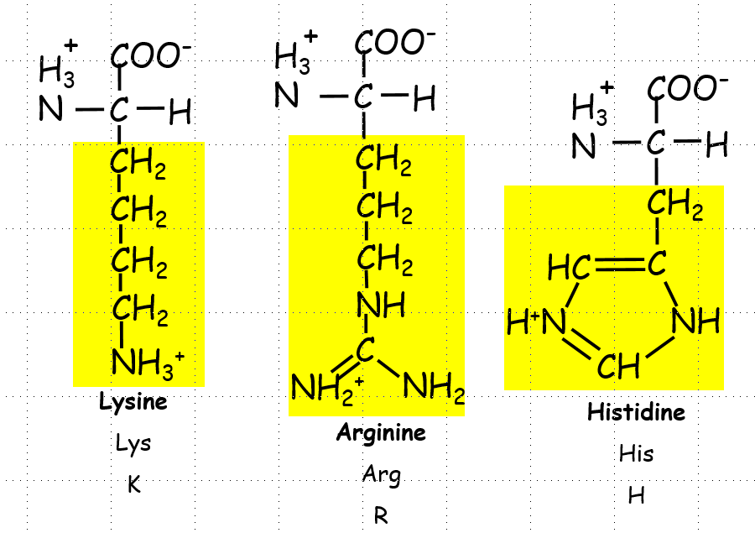
Acidic and Basic Proteins
At physiological pH (7.4), acidic proteins tend to be negatively charged and have a higher proportion of acidic amino acids.
basic proteins tend to be positively charged and have a higher proportion of basic amino acids.

Slide 8
The location of the amino acid and function of the protein
The location of amino acids is relevant for the protein’s function and its interaction with the environment.
proteins located in a hydrophobic environment, such as membrane, have nonpolar (hydrophobic) side chains on the surface interacting with the membrane lipids.
In contrast, proteins located in an aqueous environment, such as cytosol, have polar side chains (hydrophilic) on the surface interacting with the aqueous environment.
Predictably, arginine and lysine (positively charged) are found on the surface of DNA-binding proteins that interact with the negatively charged phosphate group of DNA.

Slide 9
The location of the amino acid and function of the protein
Similarly, aspartic acid and glutamic acid carry negative charges, and are often located on the interacting surface of proteins that interact with positively charged molecules.
Serine, threonine, and tyrosine have hydroxyl groups (2OH) in their side chains that can serve as phosphate attachment site during phosphorylation.
The sulfhydryl (-SH) group in cysteine is ideal for binding metals through metal—thiolate bonds.
Proline occurs near the bend of polypeptide chains, and its ring forms a useful kink in the protein chain. Therefore, proline helps redirect the protein chain back inwards or around a tight corner.

Slide 10
Peptide bonds
Proteins are sometimes called polypeptides since they contain many peptide bonds
R₁
O
H
R₂
O
+
H₃N
C
C
OH
+
H
N
C
C
O⁻
H
H
R₁
O
R₂
O
+
H₃N
C
C
N
C
C
O⁻
+ H₂O
H
H
H

Slide 11
Characteristics of Peptide Bonds
The peptide bond has a partial double-bond character.
The Cα-C bonds are not rigid and they can freely rotate

Slide 12
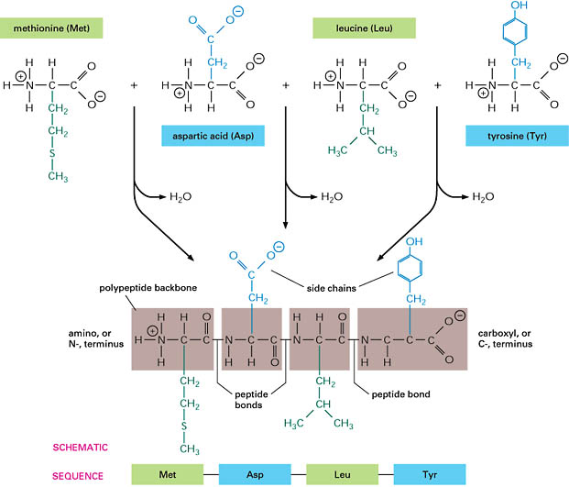
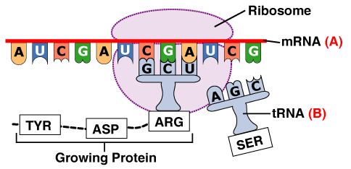
Protein Assembly
occurs at the ribosome
involves polymerization of amino acids attached to tRNA
yields primary structure

Slide 13
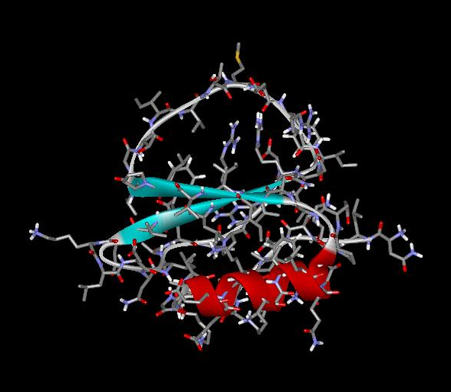
Each protein has a unique structure!
Amino acid sequence
NLKTEWPELVGKSVEEAKKVILQDKPEAQIIVLPVGTIVTMEYRIDRVRLFVDKLD
Folding!

Slide 14
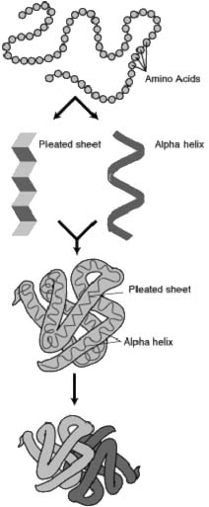
Protein Structure
Primary
Secondary
Tertiary
Quaternary
Assembly
Folding
Packing
Interaction
S T R U C T U R E
P R O C E S S

Slide 15
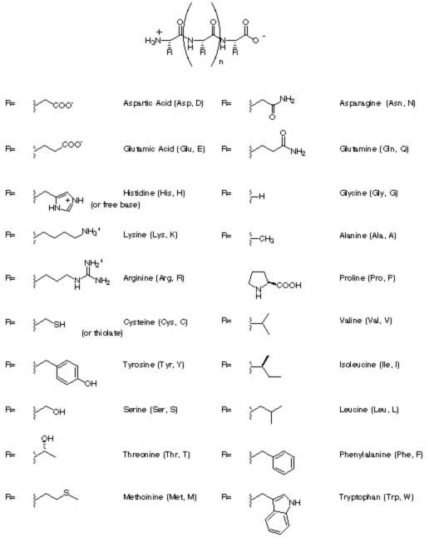
Primary Structure
primary structure of human insulin
CHAIN 1: GIVEQ CCTSI CSLYQ LENYC N
CHAIN 2: FVNQH LCGSH LVEAL YLVCG ERGFF YTPKT
linear
ordered
1 dimensional
sequence of amino acid polymer
by convention, written from amino end to carboxyl end
a perfectly linear amino acid polymer is neither functional nor energetically favorable → folding!

Slide 16
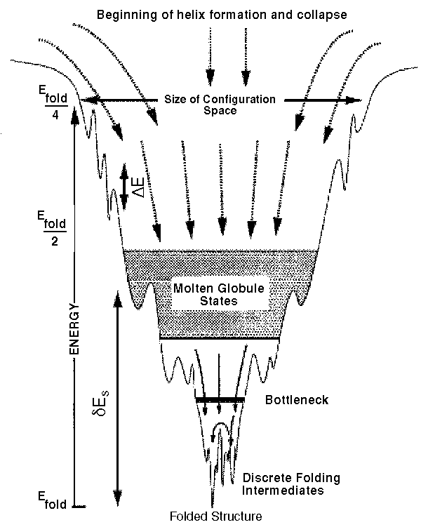
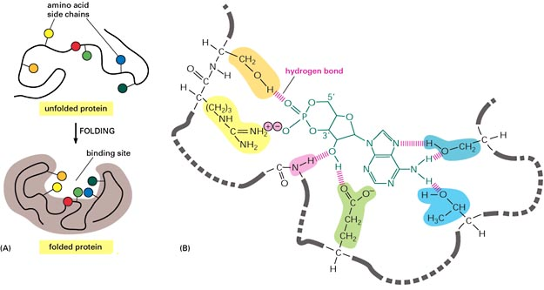
Protein Folding
occurs in the cytosol
involves localized spatial interaction among primary structure elements, i.e. the amino acids
yields secondary structure

Slide 17
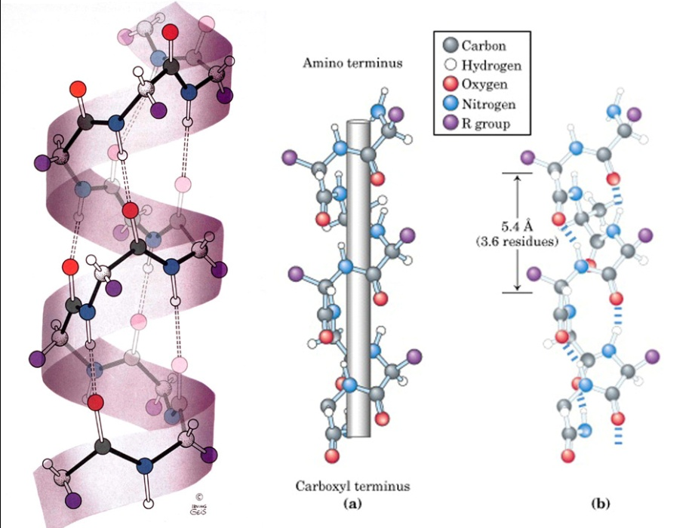
Secondary Structure
non-linear
3 dimensional
localized to regions of an amino acid chain
formed and stabilized by hydrogen bonding, electrostatic and van der Waals interactions

Slide 18
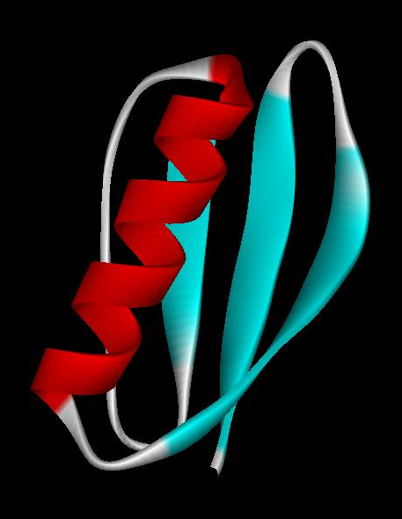
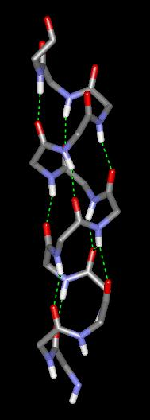
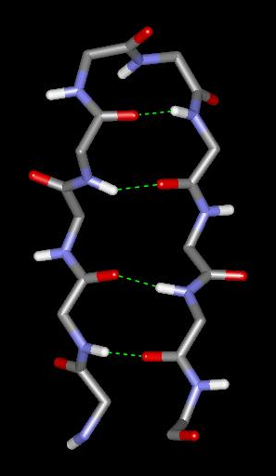
Secondary structure
α-helix
β-sheet
Secondary structures, α-helix and β-sheet, have regular hydrogen-bonding patterns.

Slide 19
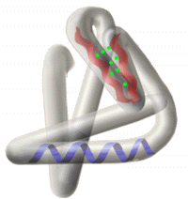
Tertiary Structure
non-linear
3 dimensional

Slide 20
Protein Interaction
occurs in the cytosol, in close proximity to other folded and packed proteins
involves interaction among tertiary structure elements of separate polymer chains

Slide 21
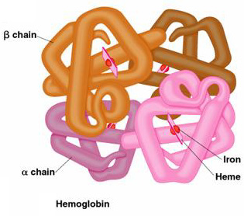
Quaternary Structure
non-linear
3 dimensional

Slide 22
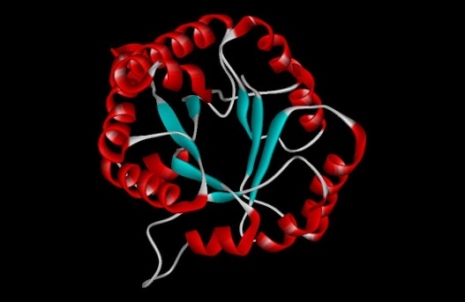
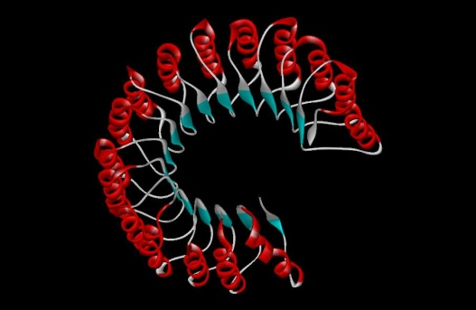
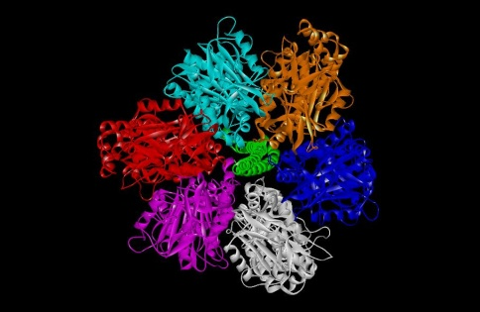
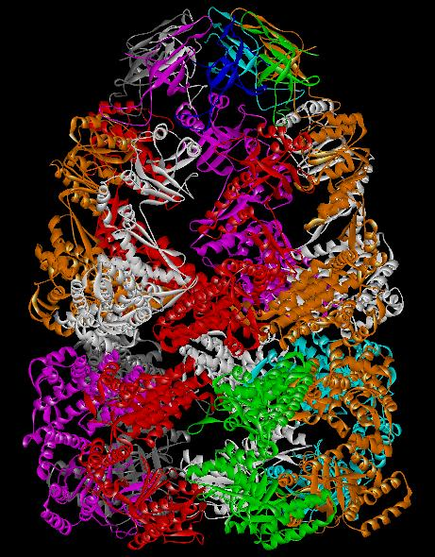
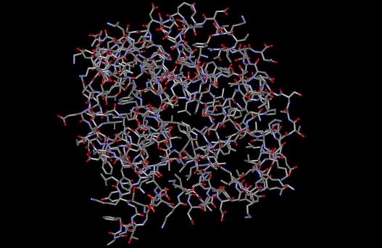
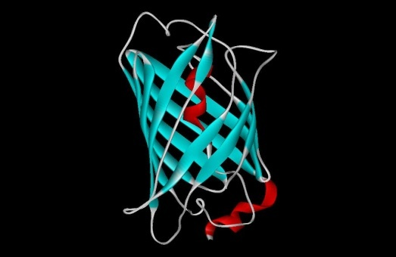
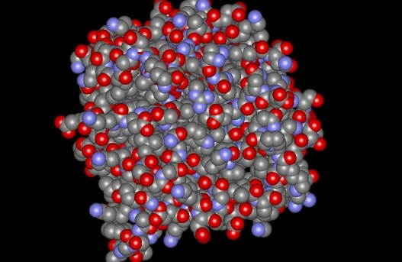
3D structure of proteins
Tertiary structure
Quaternary structure

Slide 23
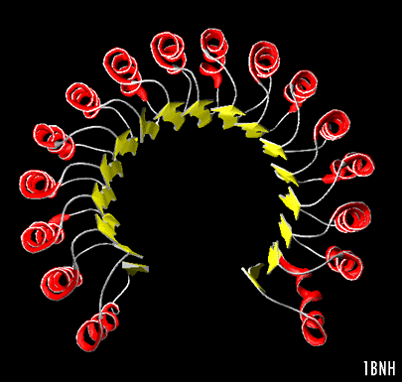
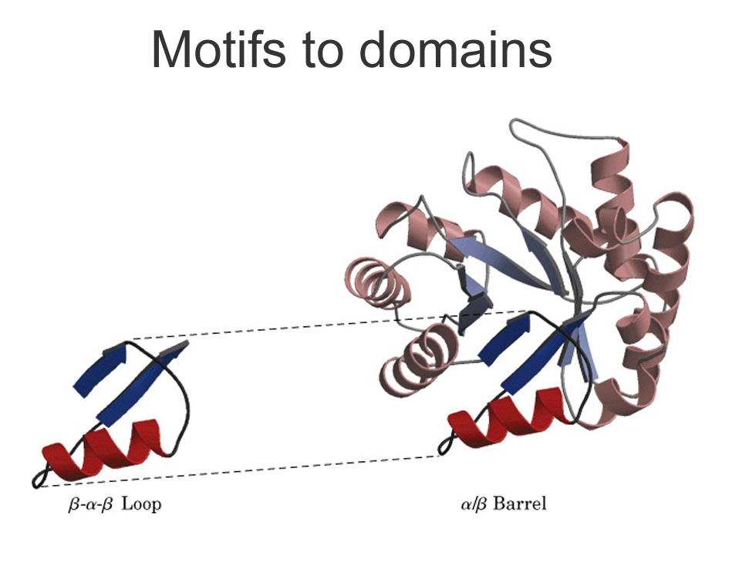
Class/Motif
class = secondary structure composition,
e.g. all α, all β, α/β , α+β
motif = small, specific combinations of secondary structure elements,
e.g. β-α-β loop
both subset of fold
α/β

Slide 24
Fold
fold = architecture = the overall shape and orientation of the secondary structures, ignoring connectivity between the structures,
e.g. α/β barrel, TIM barrel
subset of fold families/superfamilies

Slide 25
Hierarchical nature of protein structure
Primary structure (Amino acid sequence)
↓
Secondary structure （α-helix, β-sheet）
↓
Tertiary structure （Three-dimensional structure formed by assembly of secondary structures）
↓
Quaternary structure （Structure formed by more than one polypeptide chains）

Slide 26
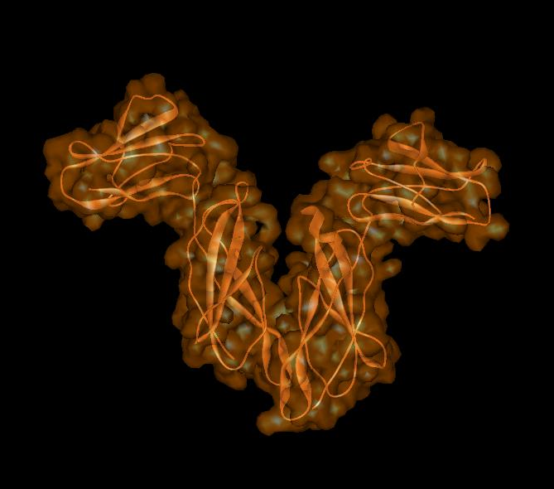
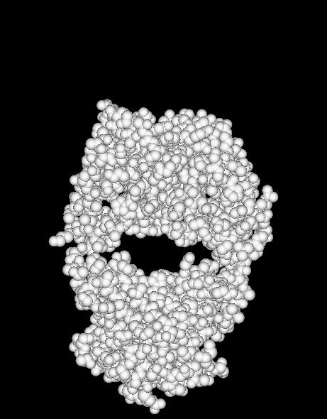
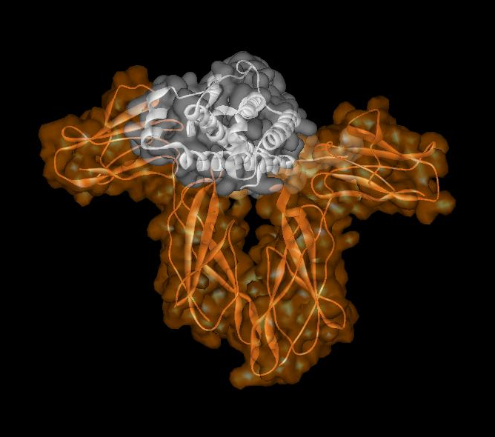
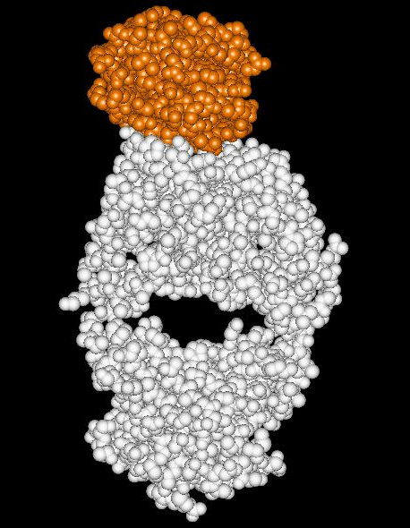
Protein structure and its function
Example of enzyme reaction
Hormone receptor
Antibody
substrates
enzyme
A
enzyme
B
Matching the shape to A
Digestion of A!
enzyme
A
Binding to A

Slide 27
Protein structure prediction has remained elusive over half a century
“Can we predict a protein structure from its amino acid sequence?”
So far Impossible!

Slide 28
Summary
Proteins are key players in our living systems.
Proteins are polymers consisting of 20 kinds of amino acids.
Each protein folds into a unique three-dimensional structure defined by its amino acid sequence.
Protein structure has a hierarchical nature.
Protein structure is closely related to its function.
Protein structure prediction is a grand challenge of computational biology.

Slide 29
Thank You

